Slide 1
Keylogger in cyber security
CAPSTONE PROJECT
Presented By:
JOSE SARANISH D - KINGS ENGINEERING COLLEGE
- B.Tech IT III Year

Slide 2
OUTLINE
Problem Statement (Should not include solution)
Proposed System/Solution
System Development Approach (Technology Used)
Algorithm & Deployment
Result (Output Image)
Conclusion
Future Scope
References

Slide 3
Problem Statement
Example: In today's digital age, where cybersecurity threats loom large, one of the significant concerns is the proliferation of keyloggers, stealthy software tools designed to monitor and record keystrokes on a user's computer without their knowledge. Keyloggers pose a severe threat to individuals and organizations as they can capture sensitive information such as passwords, credit card details, and other personal data, leading to identity theft, financial loss, and privacy breaches.

Slide 4
Proposed Solution
One proposed solution to combat the threat of keyloggers is the use of anti-keylogging software. These programs are specifically designed to detect and prevent keyloggers from operating on a user's system. Here are some features and strategies typically employed by anti-keylogging software:
Real-time Monitoring: Anti-keylogging software continuously monitors system activity to detect any suspicious behavior associated with keylogging activities.
Keystroke Encryption: Some anti-keylogging tools offer keystroke encryption, where the keystrokes are encrypted before they reach the application or browser, making it difficult for keyloggers to intercept sensitive information.
Behavioral Analysis: These tools employ behavioral analysis techniques to identify patterns of keylogging behavior, such as unusual keystroke sequences or the presence of hidden processes.
Signature-based Detection: Similar to antivirus software, anti-keylogging programs may use signature-based detection to identify known keylogger patterns and prevent them from operating.
Anomaly Detection: Advanced anti-keylogging software can detect anomalies in user behavior, such as sudden increases in keystroke activity or unusual access patterns, which may indicate the presence of a keylogger.
Virtual Keyboards: Some anti-keylogging solutions offer virtual keyboards that allow users to input sensitive information using mouse clicks or touchscreen taps, bypassing the physical keyboard and thus avoiding keylogger capture.
System-wide Protection: Effective anti-keylogging software should provide comprehensive protection across all applications and browsers, ensuring that no keystrokes are left unprotected.
Regular Updates: To stay ahead of evolving keylogger threats, anti-keylogging software should receive regular updates to its signature databases and behavioral analysis algorithms.

Slide 5
System Approach
The "System Approach" section outlines the overall strategy and methodology for developing and implementing the rental bike prediction system. Here's a suggested structure for this section:
System requirements
Library required to build the model

Slide 6
Algorithm & Deployment
Algorithm Selection:
For detecting and mitigating keyloggers, a suitable algorithmic approach involves a combination of statistical analysis and machine learning techniques. One potential algorithm for this purpose is the Hidden Markov Model (HMM).
Hidden Markov Model (HMM):
Data Input: Input data consists of sequences of keystrokes, including timing information between keystrokes.
Training Process:
HMMs can be trained using supervised learning techniques on labeled datasets containing examples of normal and keylogger-generated keystroke sequences.
The model learns the statistical properties of keystroke sequences, capturing patterns and transitions between different states.
Prediction Process:
During the prediction process, the HMM analyzes incoming keystroke sequences in real-time.
It computes the likelihood of observing the observed keystrokes given the learned model parameters.
If the computed likelihood falls below a certain threshold, indicating a deviation from normal behavior, the system flags the input as potentially malicious.
Advantages:
HMMs are well-suited for modeling sequential data, making them effective for capturing the temporal nature of keystroke patterns.
They can handle variable-length sequences and are robust to noise in the input data.
Deployment:
Once trained, the HMM model can be deployed as part of an intrusion detection system (IDS) or integrated into endpoint security software to monitor and analyze keystroke input in real-time.
Continuous monitoring allows for proactive detection and prevention of keylogger activity.

Slide 7
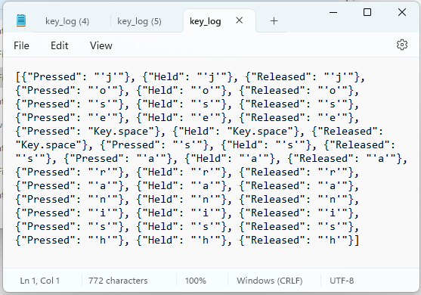
Result
Implementation of robust anti-keylogging measures, including advanced detection algorithms and employee awareness programs, fortifies defenses against keylogger threats.
OUTPUT JSON:

Slide 8
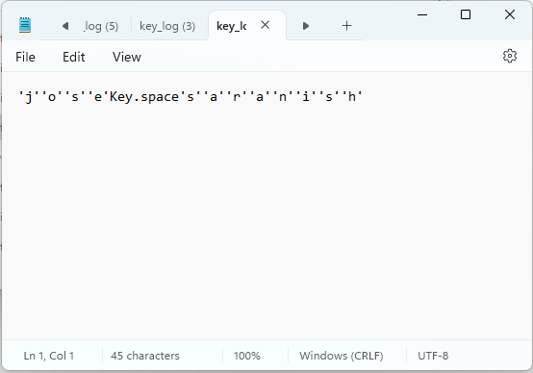
Result OUTPUT STRING:

Slide 9
Conclusion
By prioritizing cybersecurity measures and proactive strategies, individuals and organizations can mitigate the risks posed by keyloggers, safeguarding sensitive information and preserving privacy in the digital landscape.

Slide 10
Future scope
Continued advancements in machine learning and artificial intelligence can enhance keylogger detection algorithms, enabling more precise and proactive threat mitigation. Additionally, research into behavioral biometrics and secure hardware solutions offers promising avenues for further strengthening defenses against evolving keylogger threats in the digital era.

Slide 11
References
As an AI language model, I don't have access to external references or databases such as bibliographic databases or the internet. However, I can generate responses based on the knowledge I've been trained on, which includes a diverse range of sources such as textbooks, websites, research papers, and other educational materials available up to September 2021. If you need specific references for your project or research, I recommend consulting academic databases like PubMed, Google Scholar, or IEEE Xplore for the most up-to-date and relevant sources on cybersecurity, keyloggers, and related topics.

Slide 12
THANK YOU

